Slide 1
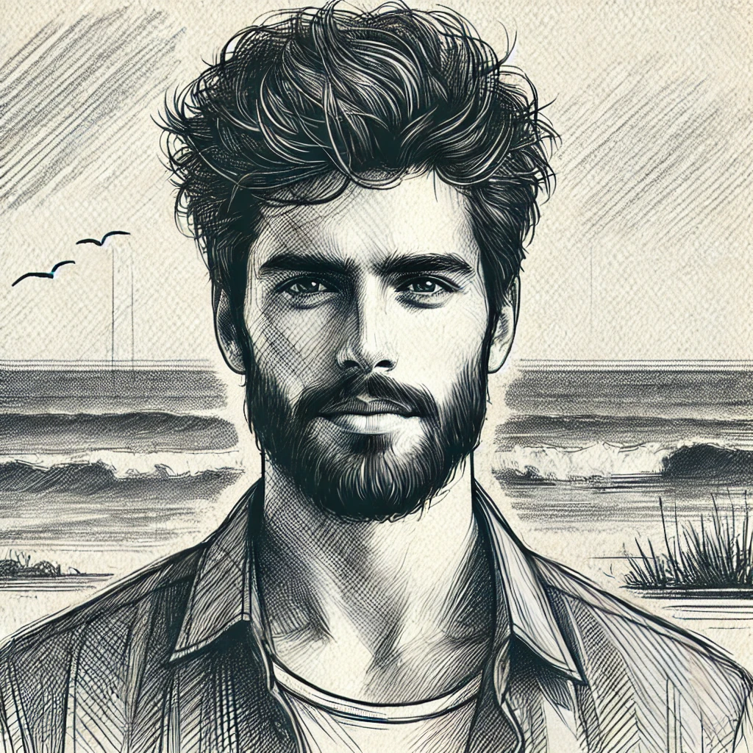
Persona Profile – Nikos Georgiou
|Paphos, Cyprus |Freelance Web Developer | Eco-Conscious Digital Nomad |
| Income: €40,000/year |Education: M.Sc. Computer Science |
Work & Lifestyle
- Left corporate tech for freedom & creativity
- Works remotely in eco-tourism & UX/UI
- Slow traveler, prefers authentic & local experiences
Motivations & Priorities
Authenticity & Sustainability (30%)
Meaningful Travel (25%)
Work-Life Balance (20%)
Local Cultural Connection (15%)
Lifelong Learning & Creativity (10%)
Travel & Tech Behavior
Uses Tourmate, Duolingo, Airbnb, Waze GPS
Relies on offline maps, eSIMs, power banks
Engages in Nomad List, Reddit (r/digitalnomad), Eco-Travel Meetups
Key Decision-Making Factors
Authenticity & Sustainability | Tech Convenience | Community Trust

